Slide 1
BATH TRAINING

Slide 2
AREAS SERVICED
PA
NJ
Counties
Counties
Bucks
Carbon
Lehigh
Monroe
Montgomery
Northampton
Hunterdon
Warren

Slide 3
Discover the Better Solution
Solid Surface
Superior Product
Same pricing as competitors if not better
Something for every customer
Kitchen Magic quality
Long after you’re gone shower will still be here.

Slide 4
WHAT ARE WE SELLING?
Tub and Shower Enclosure Only
Solid Surface and Aluminum walls and shower bases
Fixtures
Grab Bars
Shower Seats
Shower Doors
Bathtubs
Storage Pods
Corner Shelves

Slide 5
WHAT WE CAN DO
We provide new shower/tub enclosure with new Greenboard & new shower fixtures (drain must remain in same location).
We provide new alcove tubs (tubs that sit between 3 walls)
We can remove standard alcove tub and replace with new shower base to convert to shower
We provide sliding and pivot doors
We can do bath/shower with existing window
We use one crew of professionals from start to finish
We will use project coordinators the same as we do with kitchens

Slide 6
WHAT WE CANNOT DO
Cannot replace platform or electric jetted/whirlpool Jacuzzi style tubs
Cannot remove or install lion claw-foot/free-standing soaking tubs
Cannot do diagonal wall/Neo-Angle shower systems
Cannot do two wall glass shower enclosures
Cannot make shower or tub area larger-no framing or construction
Cannot relocate existing plumbing-must maintain existing drain locations
Cannot replace toilet
No electrical services by KM
Cannot do any work if the bath is on a concrete slab

Slide 7
WHY CHOOSE SHOWER MAGIC?
In Business for 45 years
Remodeled over 60,000 homes
Family-Owned Business
Superior Product

Slide 8
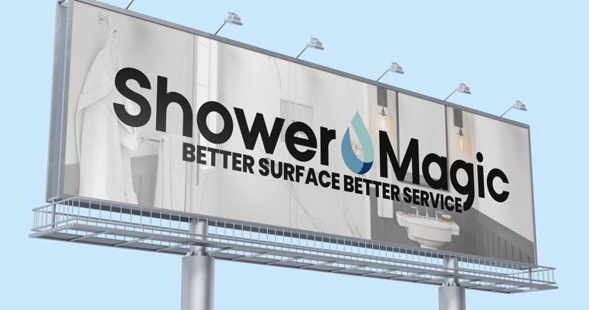

Slide 9
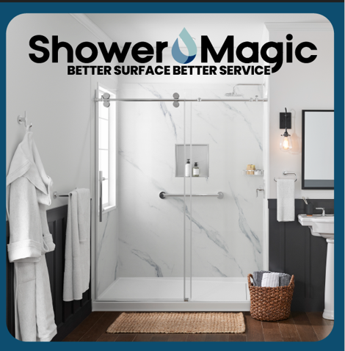
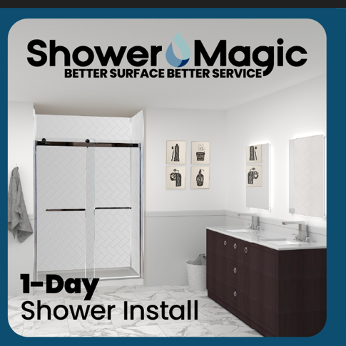
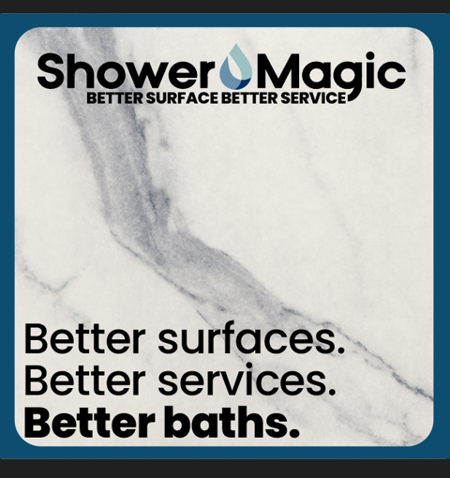

Slide 10
50% Installation Current Promo

Slide 18
